Slide 1

Notes:
Hi Good Evening – I am Anand and I had selected the CSRI Product safety spotlight as the capstone project. This presentation is an executive summary of the work we did for the last 3-4 months.

Slide 2
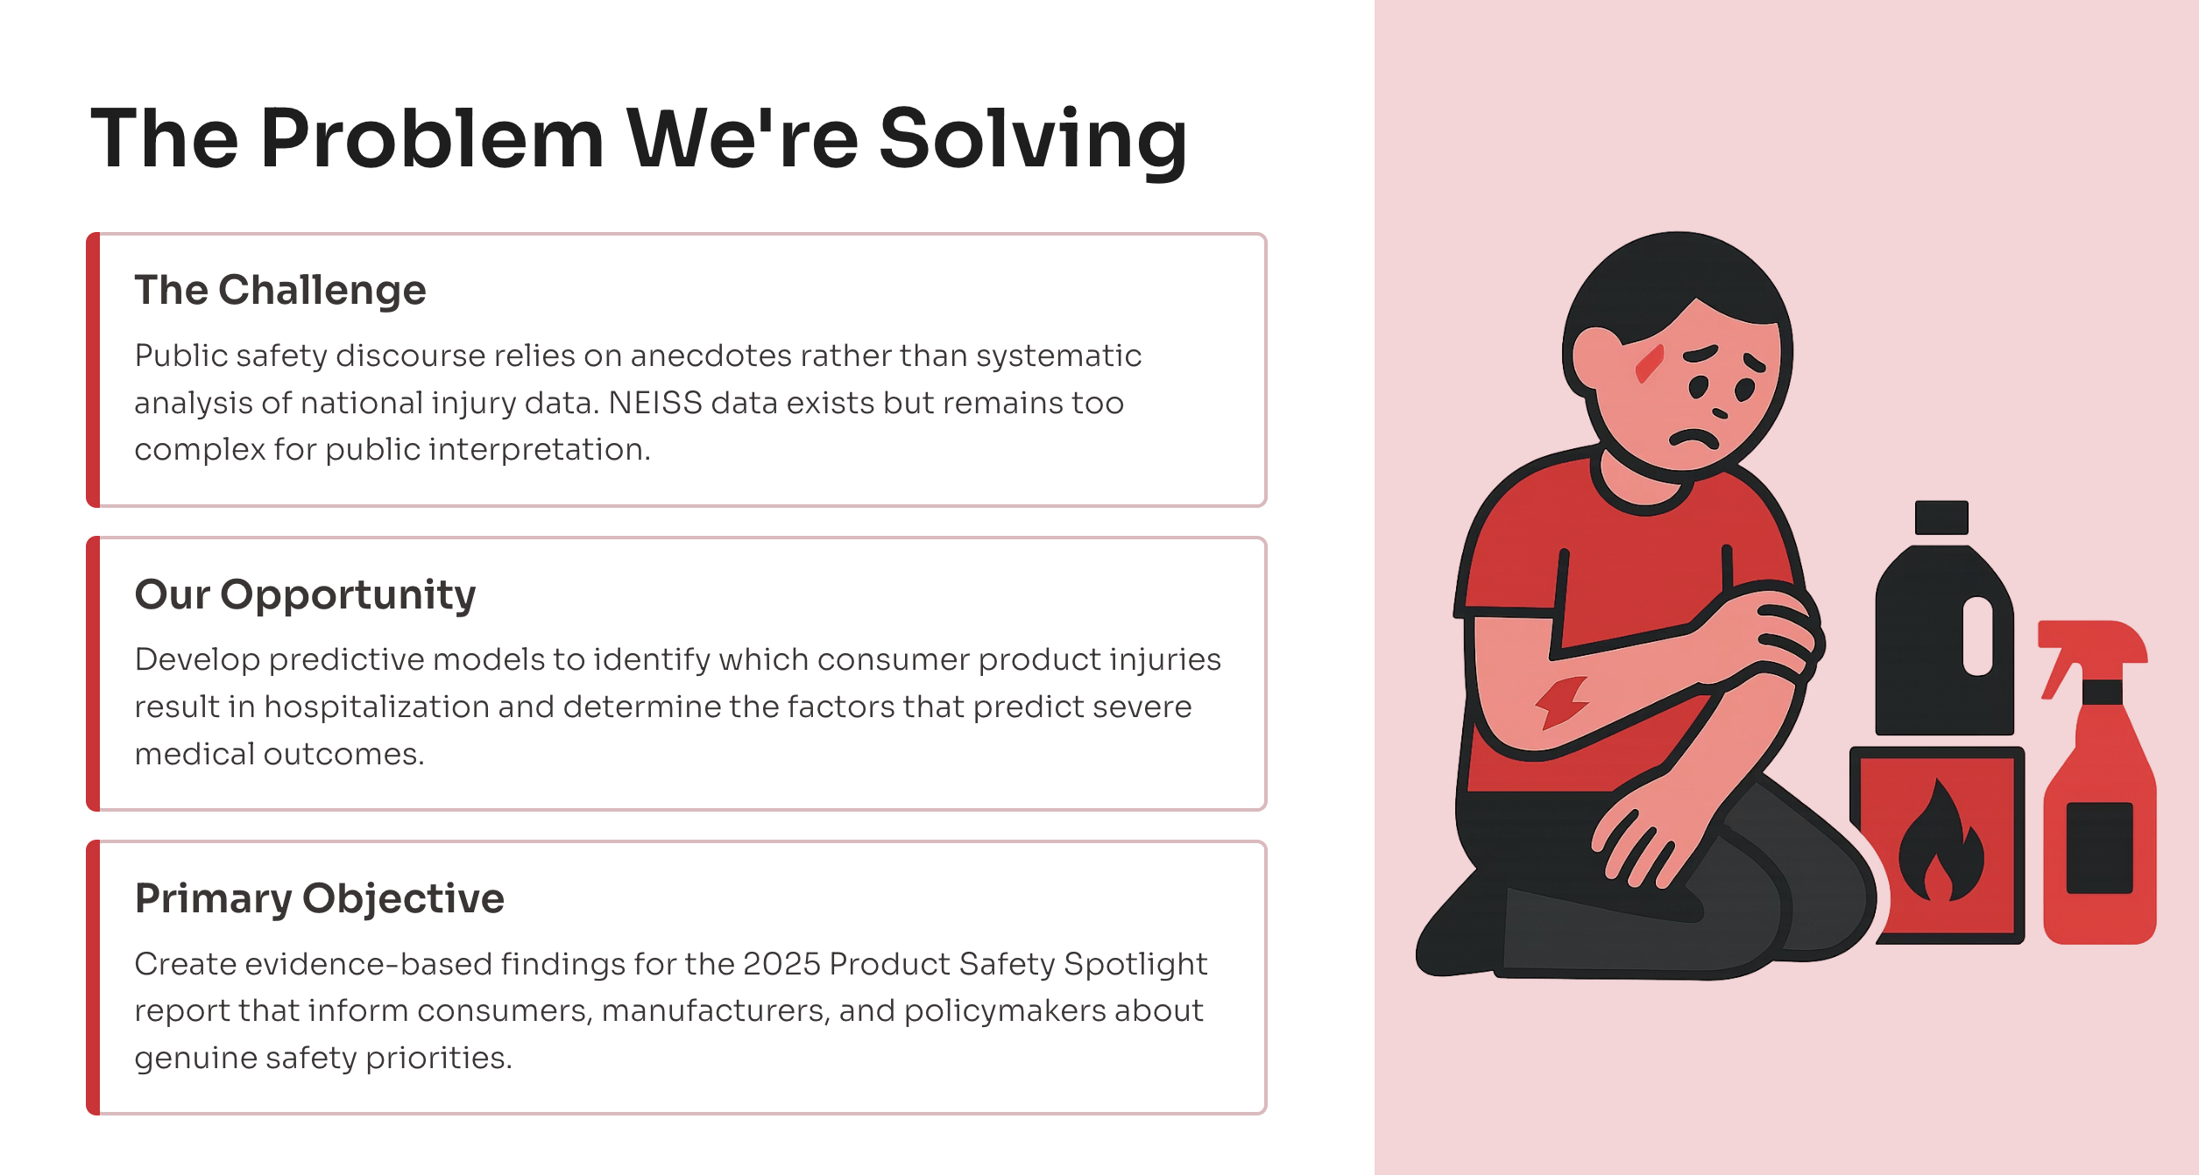
Notes:
Public discussion of consumer product safety often relies on anecdotal reports, high-profile incidents, or manufacturer marketing claims rather than systematic analysis of national injury data. The data though available, is too complex for public to interpret properly.
We need to develop predictive models to identify consumer product injuries that results in hospitalization and severe medical outcomes.
The primary objective is to create evidence based findings for 2025 product safety spotlight report to inform consumers, manufactures and policy makers about safety priorities.

Slide 3
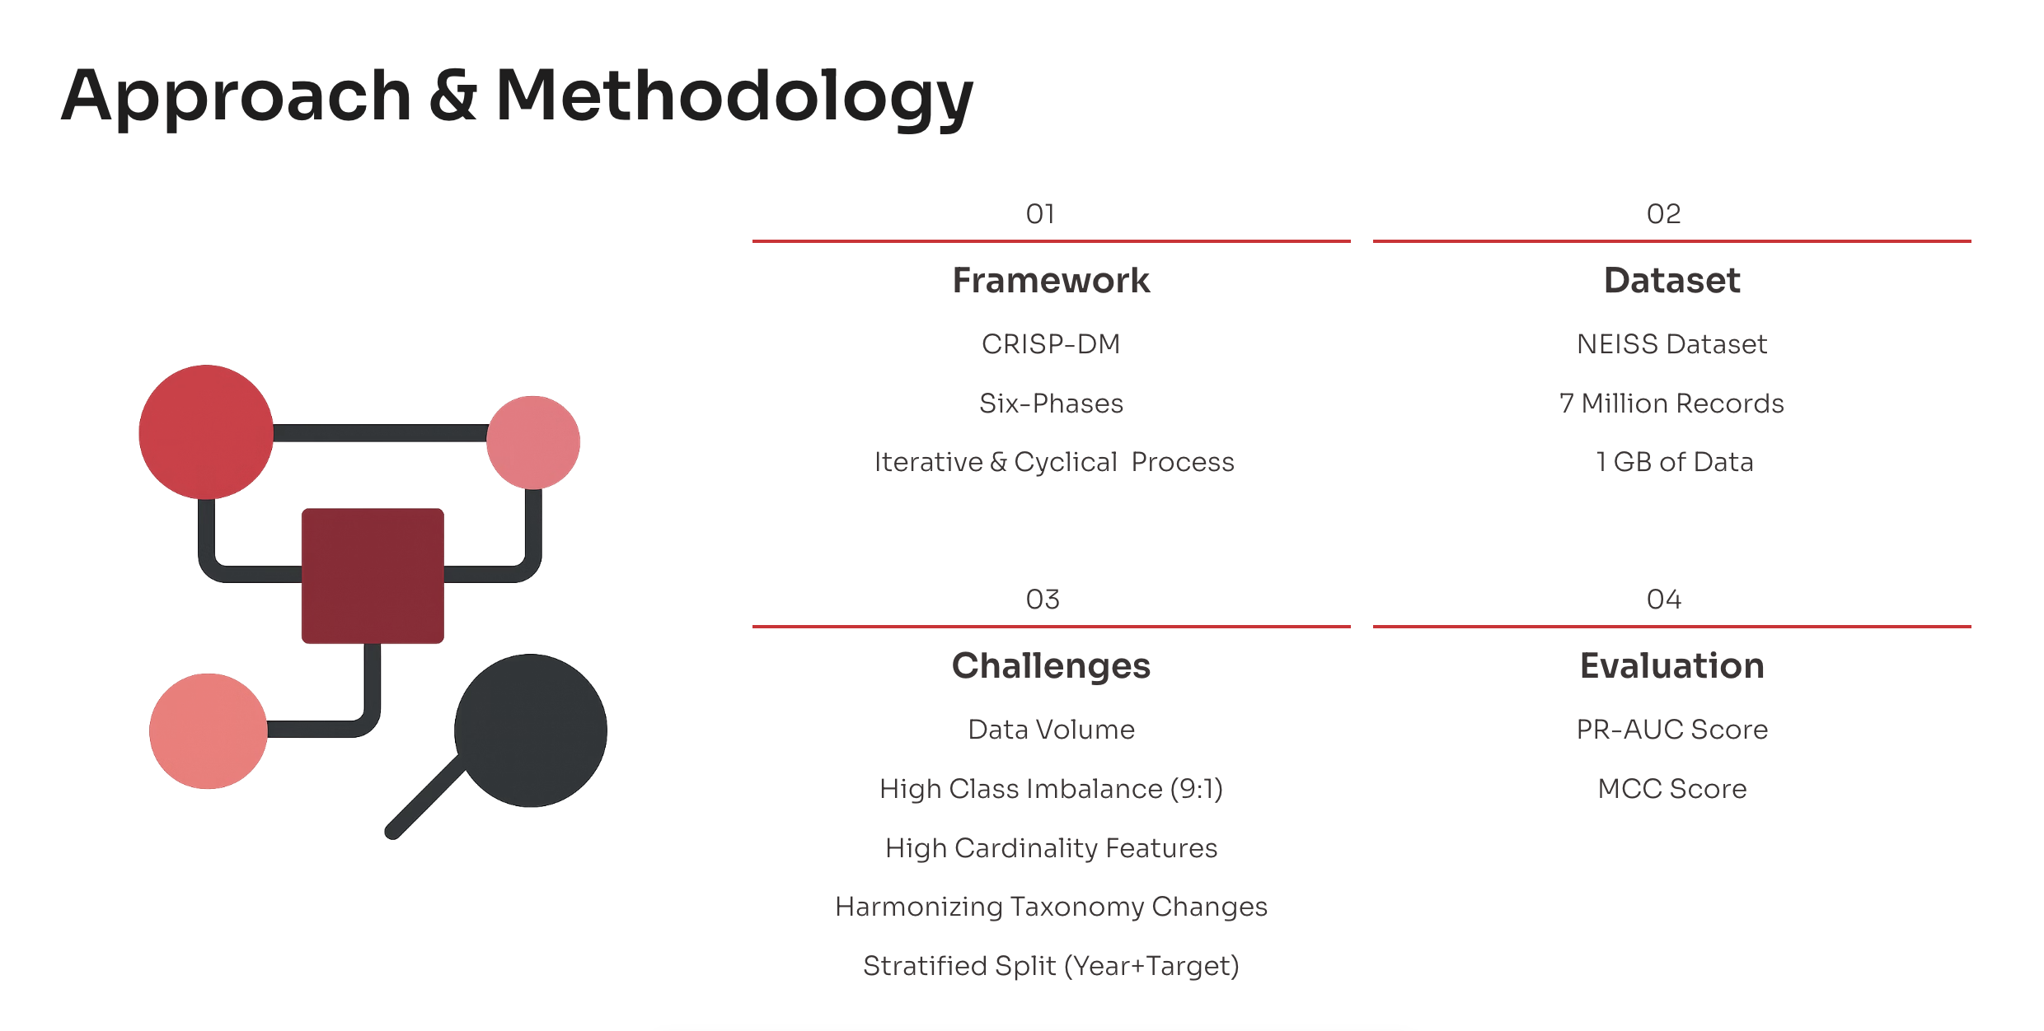
Notes:
Used Crisp-dm to execute the project,
Used NEISS dataset which has 7mil records and is 1GB in total size.
Data Volume – Creates difficulties while Training the models as we will need better hardware to perfrom the training. We also cannot use the normal Chi-Sq test and needs to use Cramers V rule to identify the impact the features has on the target variable.
Class Imbalance – The dataset was highly imbalaned and the algorithms will thus be mathematically inclined to predict majority class
Some feature's like products had a High Cardinality – Creates curse of high dimensionality
Harmonizing Product Taxonomy Changes – Every year NEISS creates new product definitions, reclassifies products, or expiries some products. We had to make sure that the models gets enough/consistent data to perform the predictions.
Stratified Split (Year + Target as the stratified Key) – As the data is imbalanced, we need to use the technique of stratified split using the stratified key (year + target variable) to make sure that the Train, test and holdout sets maintain the same imbalance through the years.

Slide 4
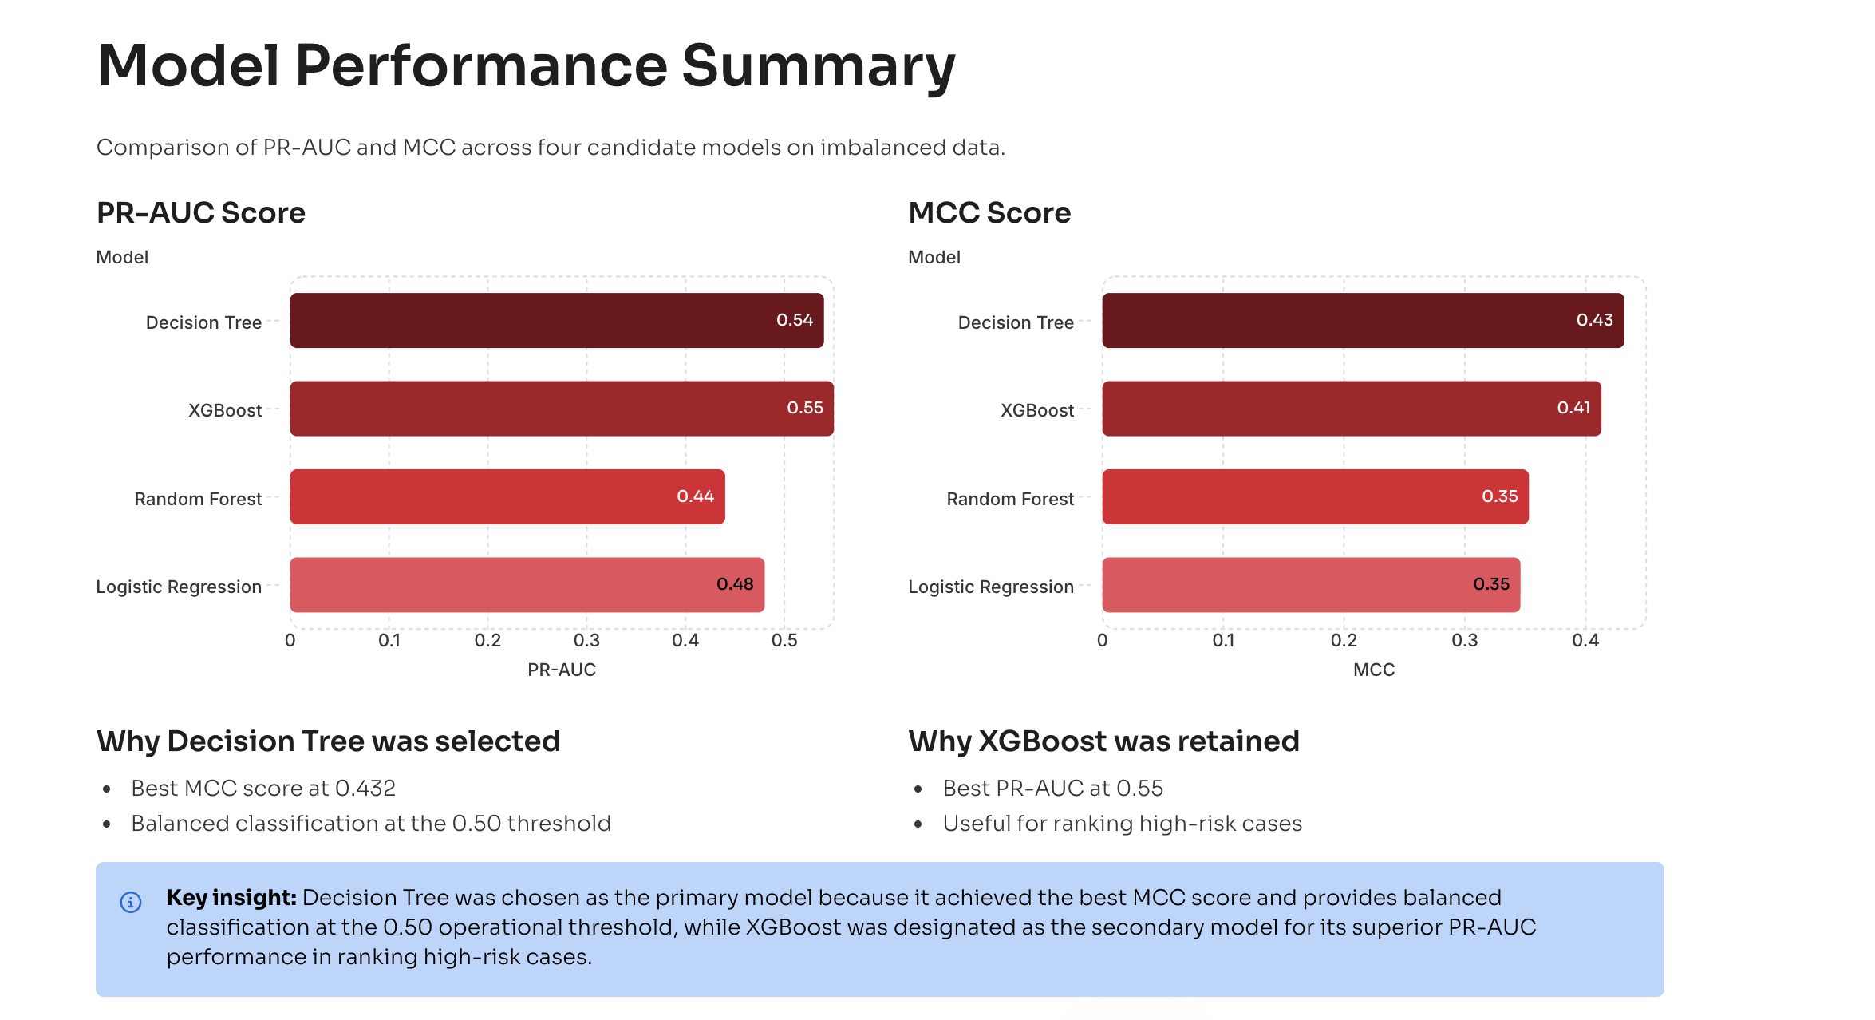
Notes:
I trained 4 estimators during the data modelling phase (with log reg as the baseline) and evaluated the models on two metrices PR-AUC Score and MCC Score.
The XGBoost scored better than any models in PR-AUC metrics and the decision tree scored better than other models when MCC score was compared.
I selected Decision tree as the primary model due to the high MCC score (better classification for the default 0.50 threshold) and for its interpretability.

Slide 5
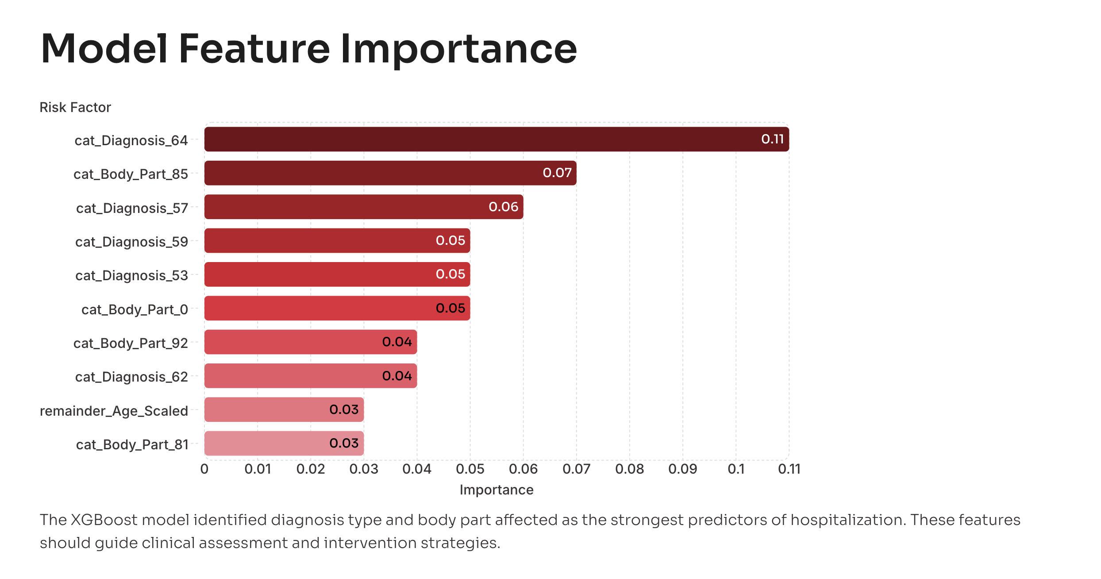
Notes:
Below features were identified as XGBoost as strongest predictors.
1. Diagnosis
2. Injured body part
3. Age Group
These features should guide the assessment an intervention strategies during the deployment phase.

Slide 6
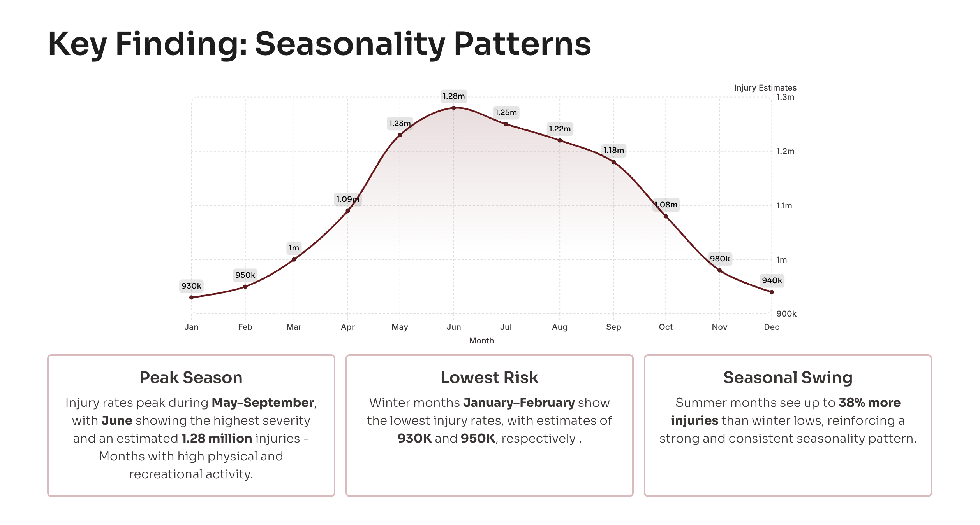
Notes:
We were able to identify seasonality patterns in the data. We find that
Injuries peaks from May – Sept (highest being in June) – reflecting months with high physical activity.
Lowest injury counts were observed during – Jan through Feb
Overall, summer months shows a 38% increase in the injuries when compared to winter months.

Slide 7
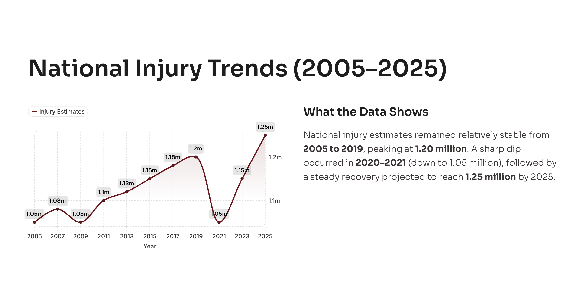
Notes:
National Injury trends shows a stable pattern from 2005-2019 and then a dip in 2020 -2021 due to the pandemic and then recovering to post pandemic highs.

Slide 8
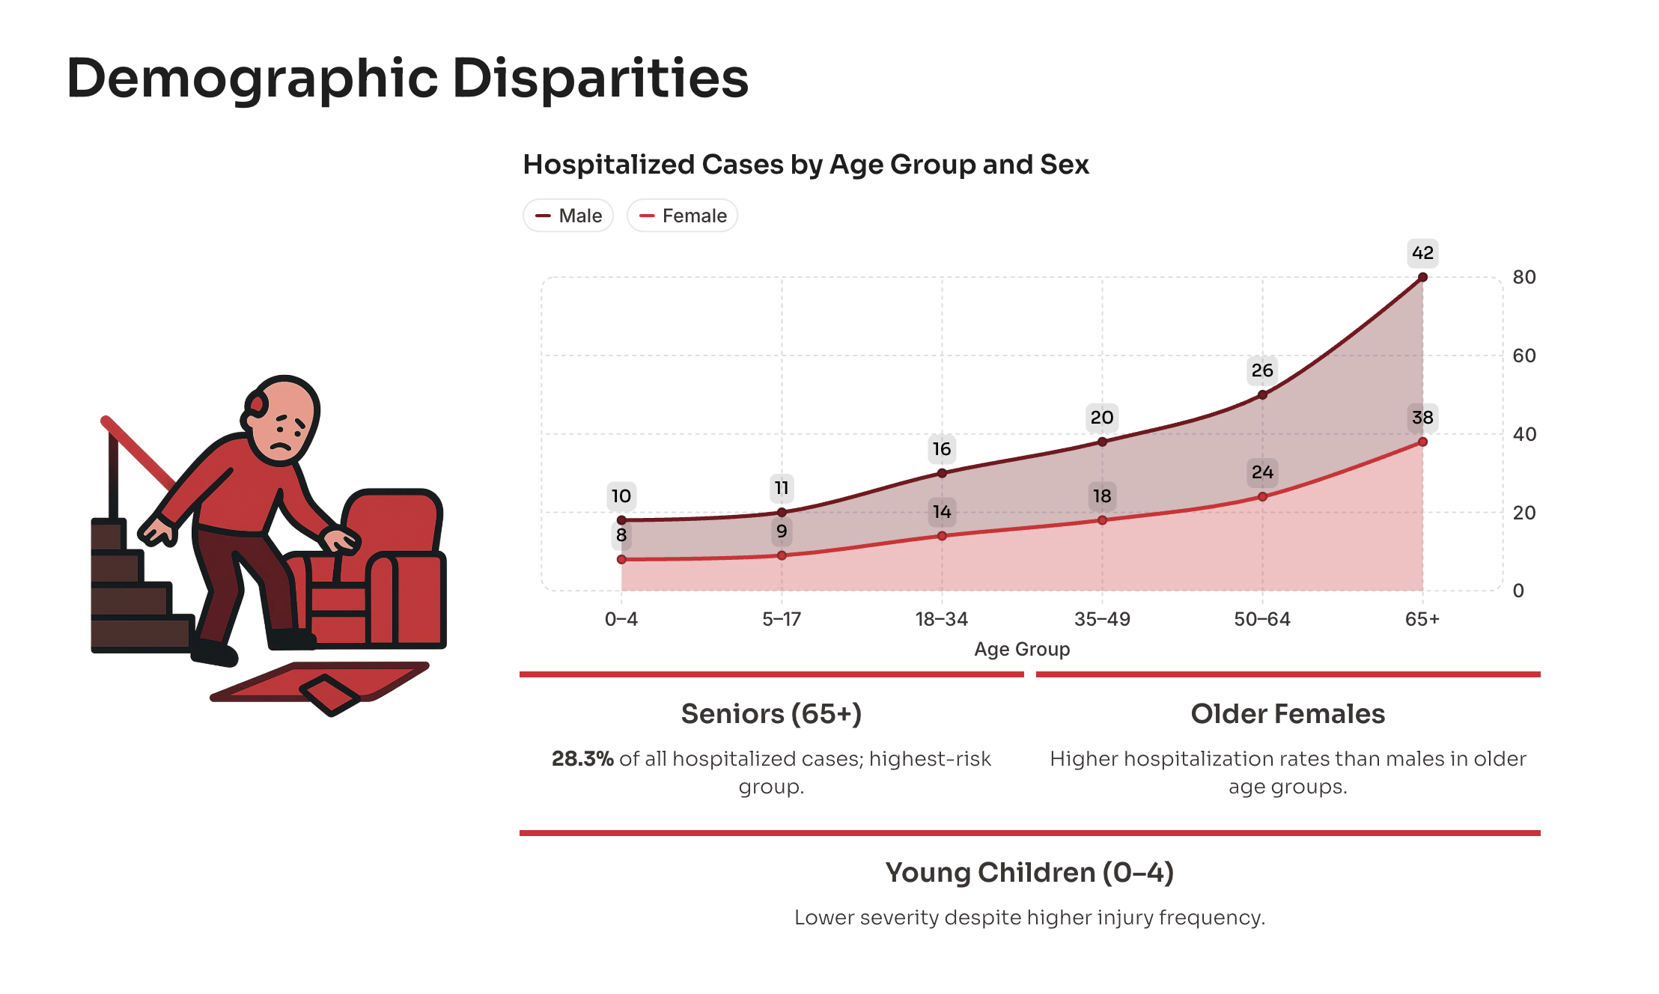
Notes:
We see 28% of all hospitalized cases are seniors (age >65) – they are the highest risk group and hence needs special attention.
We also observe that the hospitalization is higher among females in that group.
Surprisingly though the Injury frequency was high in children those were often with less seviarity.

Slide 9
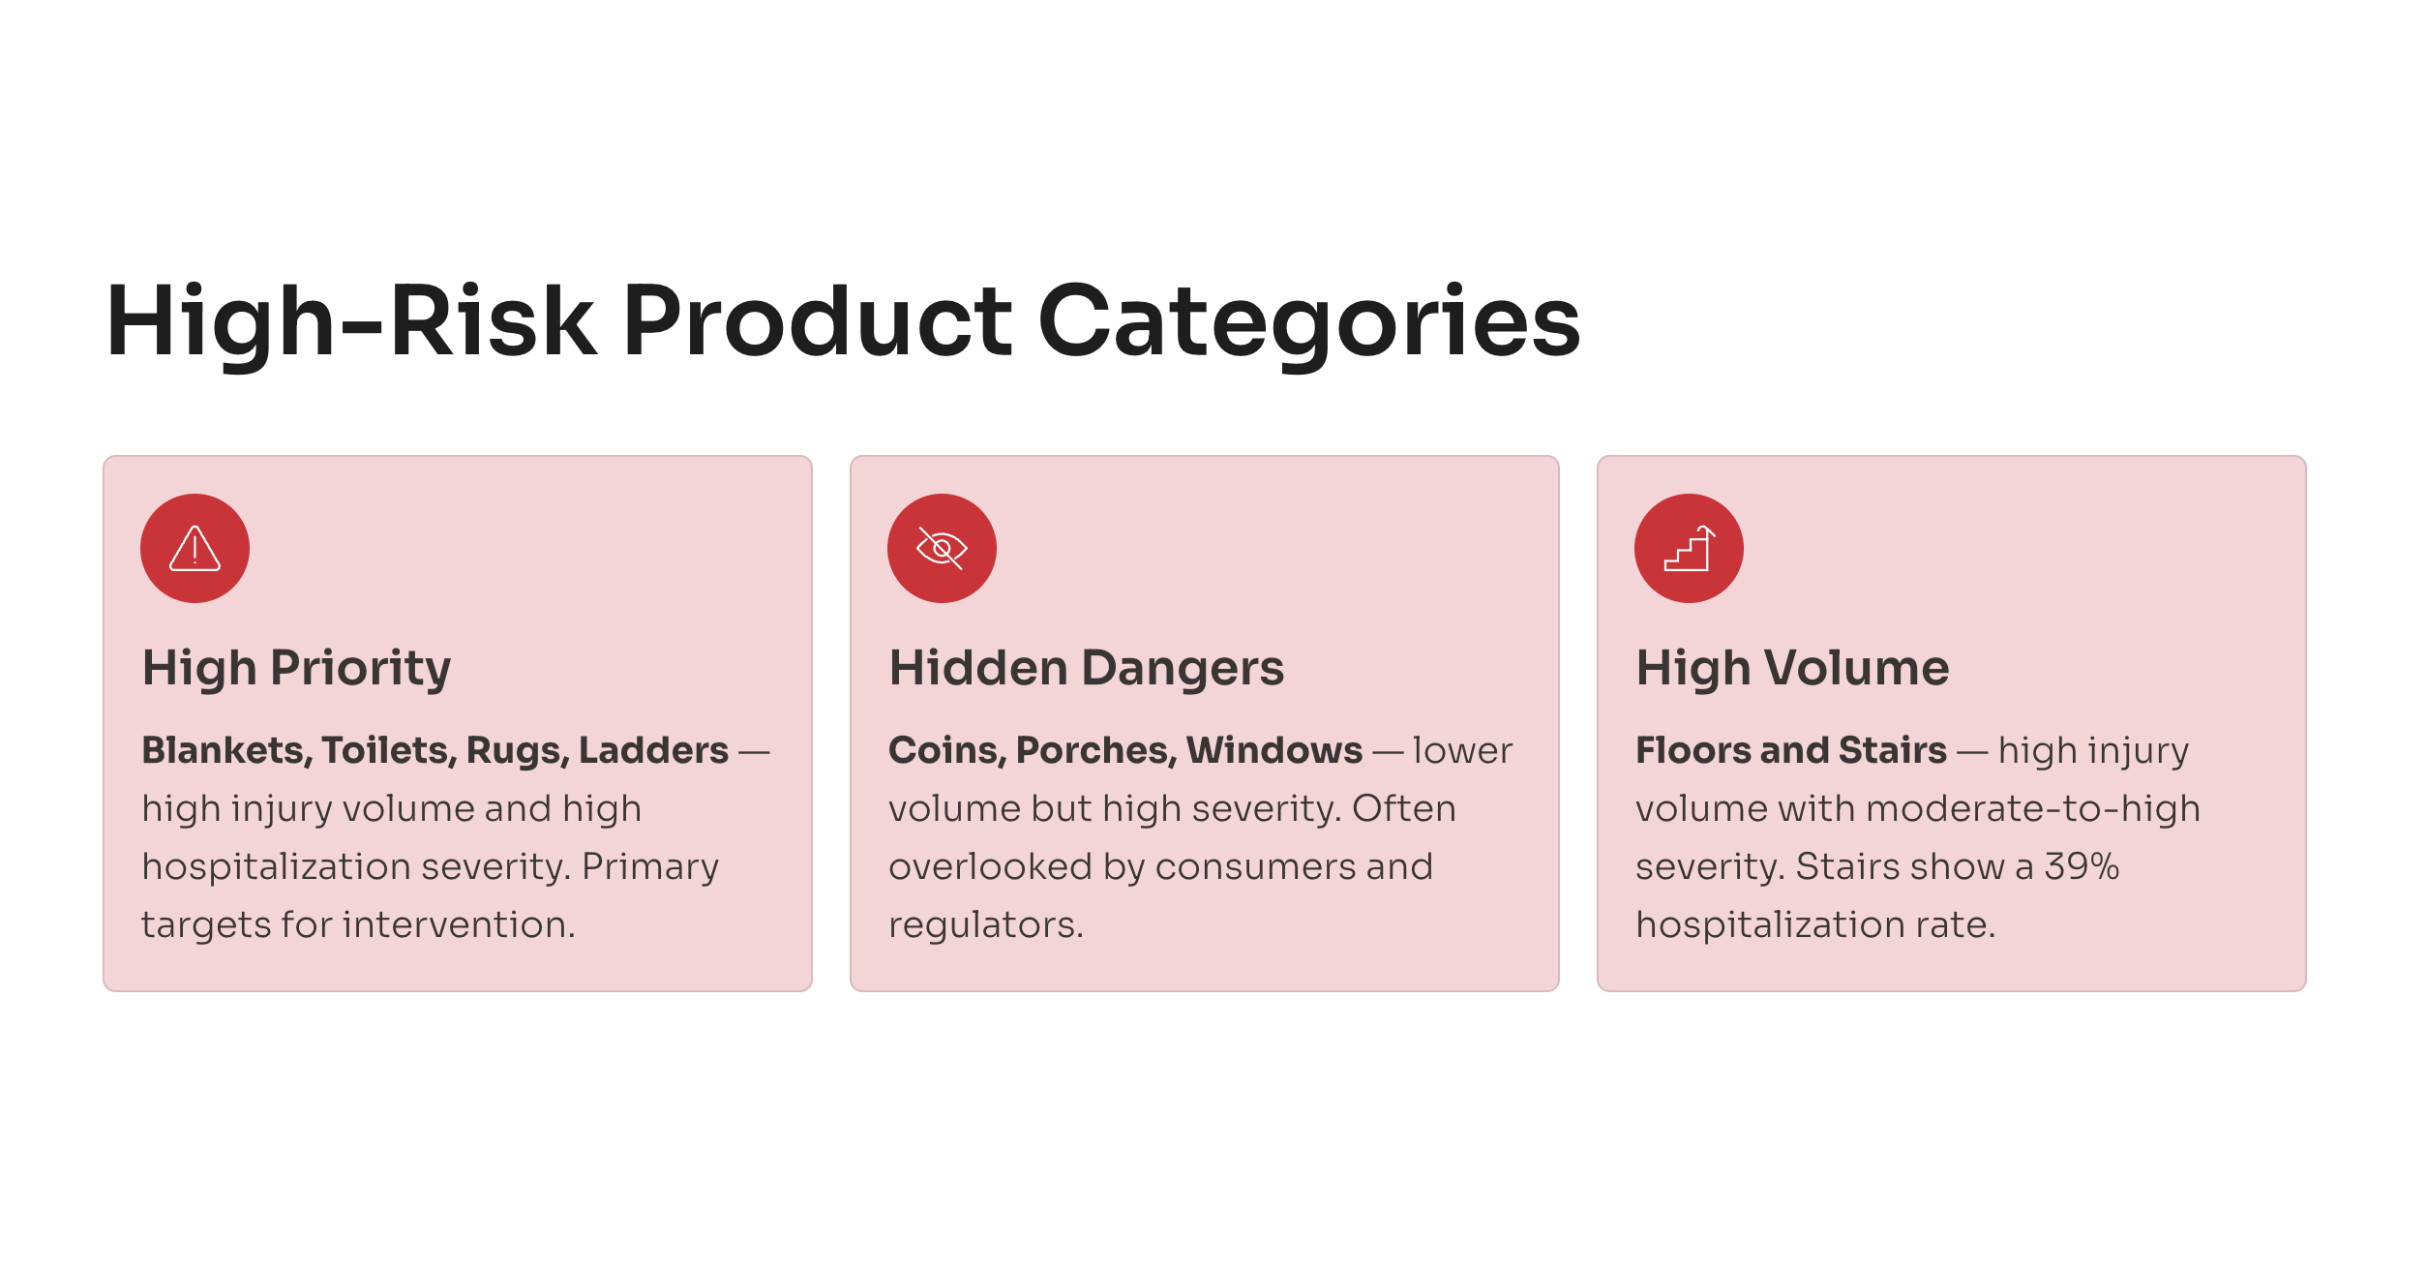
Notes:
High Risk Products
High Priority – Blankets, Toilets, Rugs, Ladders (Slip/Fall) – High injury volume and high hospitalization seviarity.
Hidden Dangers – Coins (Swallows), Porches, Windows (Slip and Fall Risk) – Low injury volume but high seviarity
High Volume Injuries – Floors, Stairs (with Stars showing 39%higher hospitalization rate) – High injury volume with moderate-high seviarity.

Slide 10
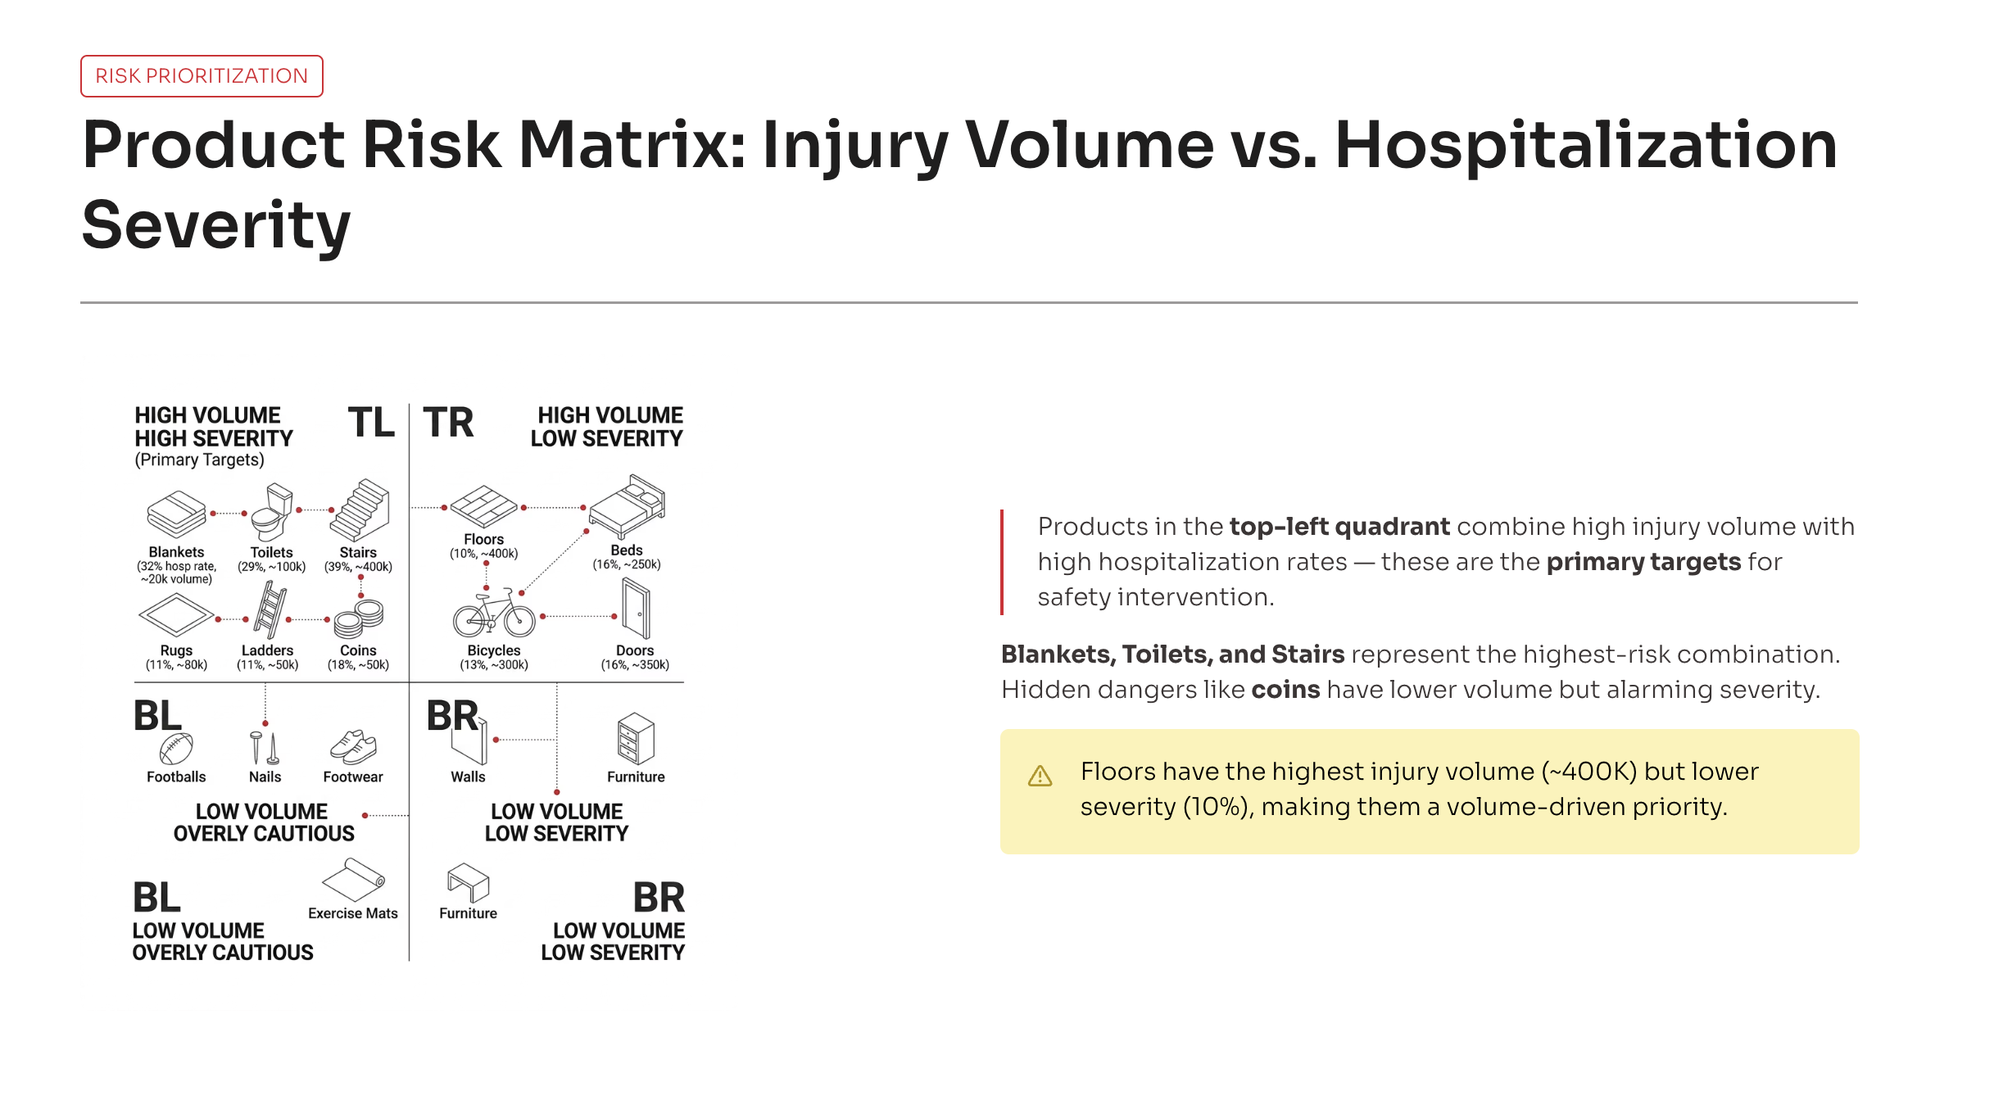
Notes:
Floors have highest injury volume but lower seviarity.

Slide 11
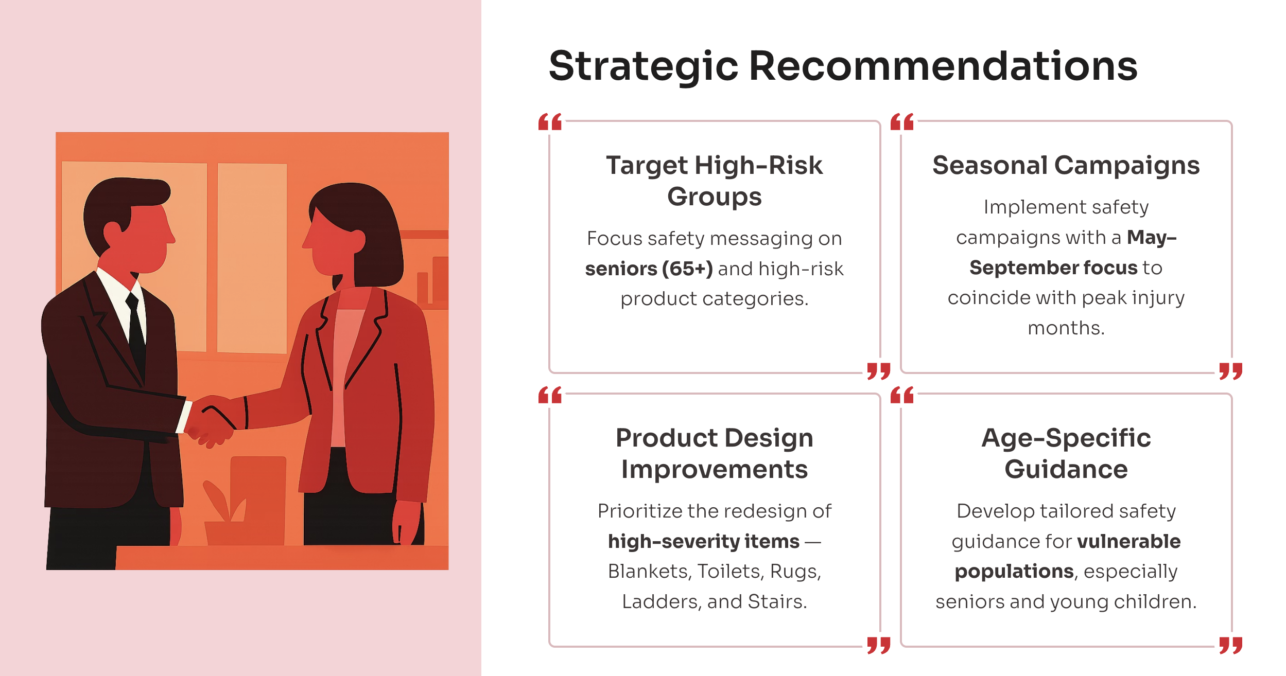

Slide 12


